Slide 1
Flight Investigator
Team
Edward Akoto
Lydian Lee
Madhok Shivaratre
Rashmi Devarahalli
Vidya Pissaye
Course : Architecture and Design (96-705)
Instructor: Jia Zhang, Ph.D
Semester: Fall 2012

Slide 2
Agenda
Introduction
Project Background
Key Concerns
Architectural design
ATAM Justification and Implementation
Prototype
Conclusions
Future work
Q & A

Slide 3
Introduction
Project Objective
To develop and analyze an architecture for a cloud based application, leveraging new and pre-existing software components, made available as services.
Scope
To demonstrate an application that uses SAP HANA database to analyze historical and current weather data, in order to verify timeliness of flights.

Slide 4
Introduction
Project Objective
To develop and analyze an architecture for a cloud based
application, leveraging new and pre-existing software
components, made available as services.

Slide 5
Project Background
An application that uses SAP HANA database.
Cloud based Real time Analysis
Share developer experience with open source community.

Slide 6
Related Work
Flight Caster (www.flightcaster.com)
Flight Stats (www.flightstats.com)
Toobler.com (toobler.com/flightdelay)
…

Slide 7
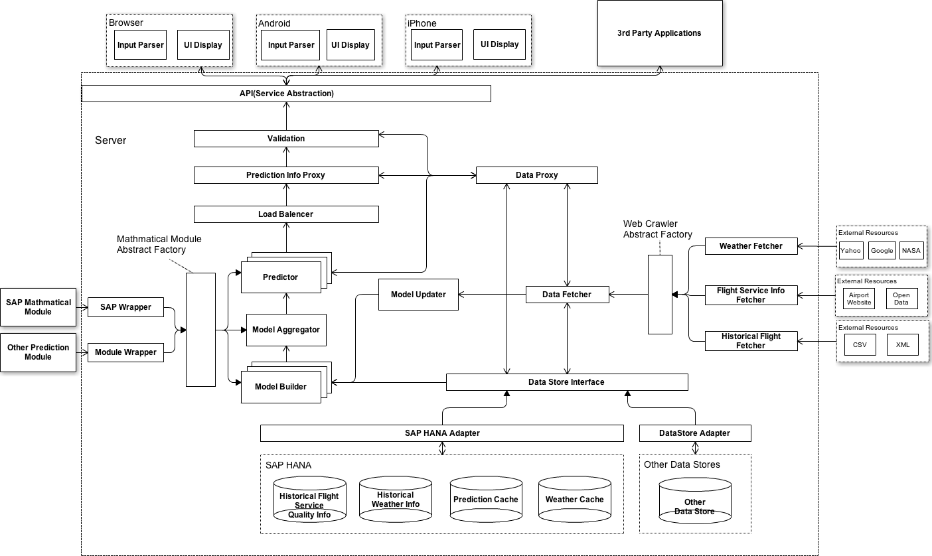
Architecture Design

Slide 8
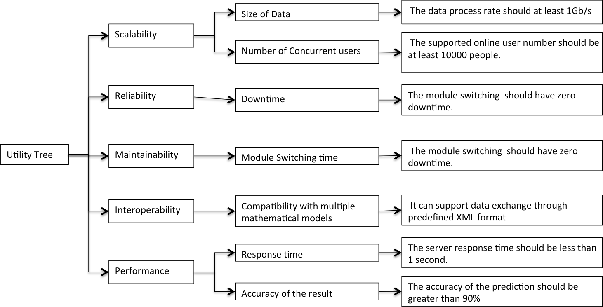
ATAM Justification

Slide 9

Implementation

Slide 10
Prototype

Slide 11
Key Concerns

Slide 12
Component based architecture

Slide 13
Conclusion
Notes:
. provides

Slide 14
Questions

Slide 15
Software Architecture
Client Application (Web, iPhone, Android)
3rd Party Application
Service API
External Mathematical
Library
Mathematical Prediction
Model
Data Fetcher
External Web services
Database Operator
Server

Slide 16
Software Architecture
Client Application (Web, iPhone, Android)
3rd Party Application
Service API
External Mathematical
Library
Mathematical Prediction
Model
Data Fetcher
External Web services
Database Operator
Server

Slide 17
Client Side
Input Parser
Display
Input Validation
Client
Query Parameter and Logical Validation
Server
Service API
Load Balancer

Slide 18
Software Architecture
Client Application (Web, iPhone, Android)
3rd Party Application
Service API
External Mathematical
Library
Mathematical Prediction
Model
Data Fetcher
External Web services
Database Operator
Server

Slide 19
Mathematical Prediction
Mathematical Prediction Abstract Factory
Model Predictor
Data Fetcher
SAP Module
SAP Wrapper
Model Aggregator
Other
Library
Other Library
Wrapper
Model Builder
Model
Updater
Database Operator

Slide 20
Software Architecture
Client Application (Web, iPhone, Android)
3rd Party Application
Service API
External Mathematical
Library
Mathematical Prediction
Model
Data Fetcher
External Web services
Database Operator
Server

Slide 21
Data Fetcher
Web Crawler Interface
Data Proxy
Weather Info Crawler
External Web Resources
Flight Info Crawler
Database Operator
Historical Info Crawler
HANA

Slide 22
Software Architecture
Client Application (Web, iPhone, Android)
3rd Party Application
Service API
External Mathematical
Library
Mathematical Prediction
Model
Data Fetcher
External Web services
Database Operator
Server

Slide 23
Database Operator
Database Operator Interface
HANA Adapter
Other Type DB Adapter
HANA
Other Type DB

